Slide 1
PHSE
Altered Images
Remember that today’s lesson is all linked to Children’s mental health week. Read through the next few slides carefully.

Slide 2
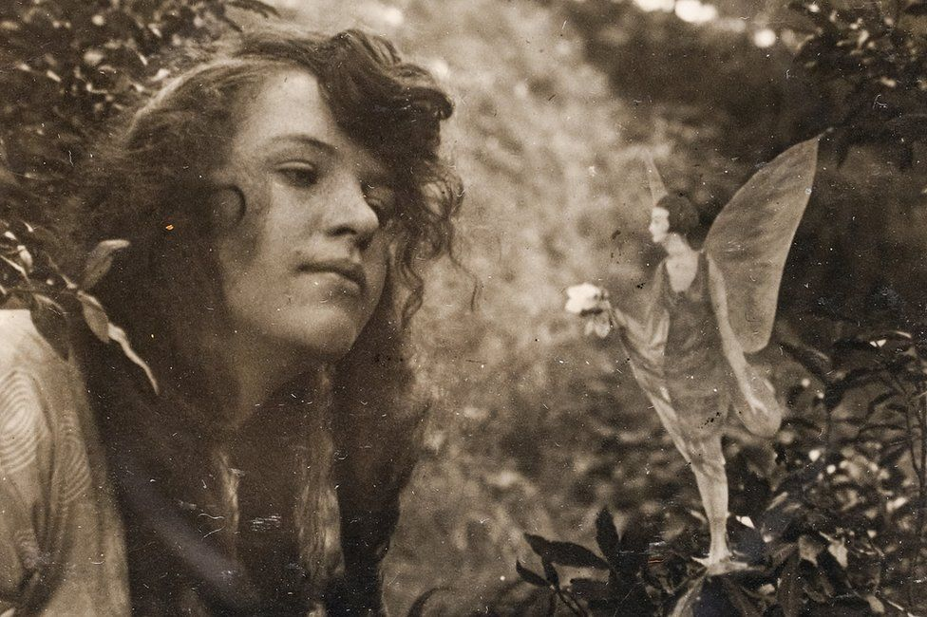
PHSE
Altered Images
This is one of the famous
fake Cottingley Fairies
photographs.
These pictures were taken in 1917 by 16-year-old Elsie Wright and her nine-year-old cousin Frances Griffiths in the village of Cottingley, near Bingley in Yorkshire.
People at the time thought these photos proved that fairies are real.
The hoax fooled many people including Sherlock Holmes author Sir Arthur Conan Doyle.
Just two of these old photos sold in 2019 for £20,000
These girls wanted to fool the experts but WE wouldn’t fall for that today, WOULD WE?

Slide 3
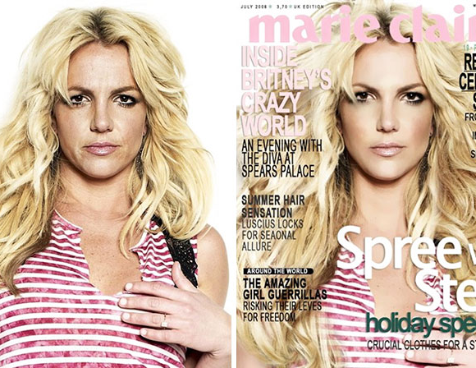
Images in the media
Today’s lesson is about Images in the media and why companies use tools to edit and change photos.

Slide 4
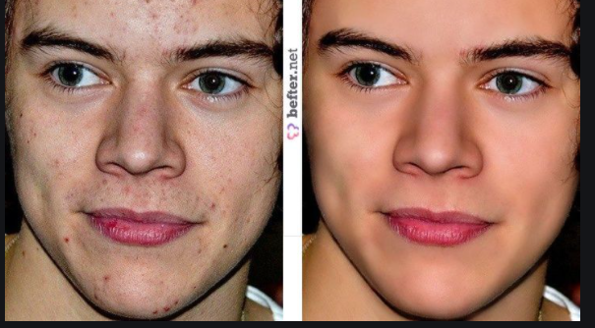
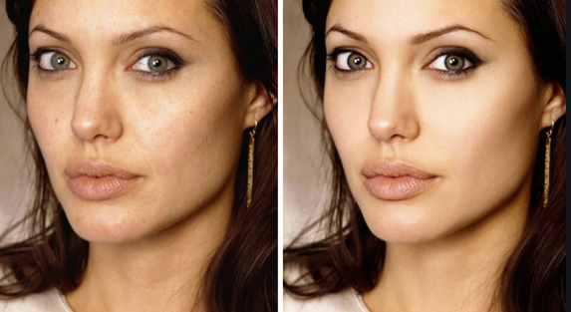
A picture is a great way to convey your message quickly to an audience without them reading through a lot of text. Images can be easily shared by other people, which means your story will be seen be a larger audience.
But is that image the truth?
Start Watching the following online lesson (the first few minutes are a warm up)
Click on the link below and follow what it is asking you :-
Images in the Media Lesson (Click Here)
At the end of the lesson you will write a postcard to some one you know telling them they are great - just the way they are. See if you can do this In only 25 words as a bonus challenge!

