Slide 1
The UK – Lesson One
LO: To identify the characteristics of the 4 countries that make up the UK.

Slide 2
LO: To identify the characteristics of the 4 countries that make up the UK.
Over the last week, we have started looking at the four countries that make up the UK: England, Scotland, Wales and Northern Ireland.
Watch this short video clip about the UK.
Geography KS1/KS2: The United Kingdom - BBC Teach
Can you remember the names of the capital cities?

Slide 3
LO: To identify the characteristics of the 4 countries that make up the UK.
The capital city of England is London. We have been learning about London in our English lessons.
We live in Leeds, which is also in England.
Have a look at the pictures on the next slide and discuss with a grown up what you the pictures tell you about England.

Slide 4
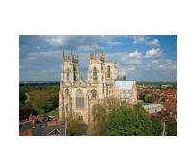
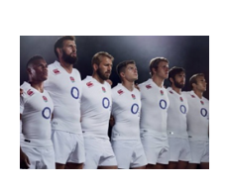
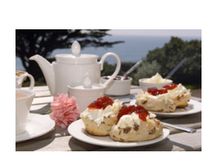
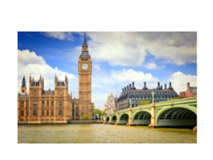
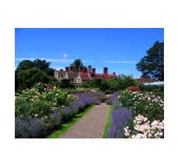
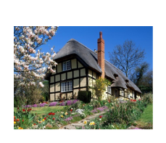
England

Slide 5
LO: To identify the characteristics of the 4 countries that make up the UK.
The capital city of Wales is Cardiff.
Have a look at the pictures on the next slide and discuss with a grown up what you the pictures tell you about Wales.

Slide 6
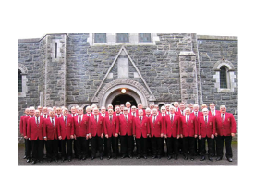
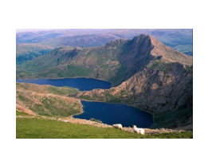
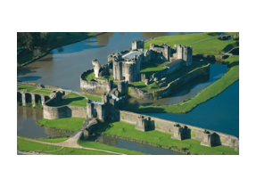
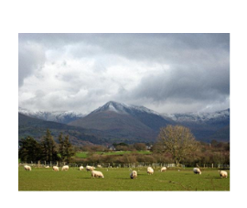
Wales

Slide 7
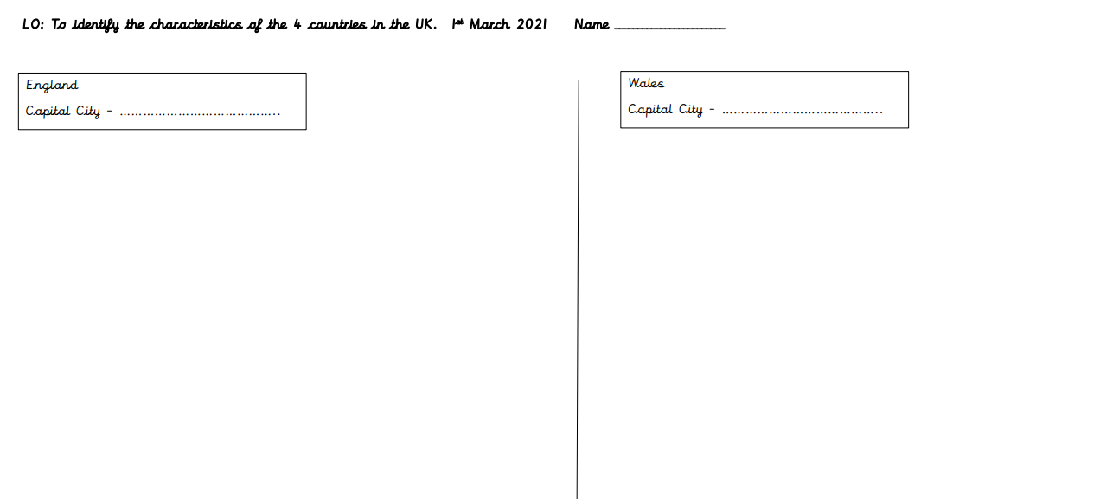
LO: To identify the characteristics of the 4 countries that make up the UK.
Your task is to divide a piece of paper into two or use the resource sheet provided.
Write down the capital city of each country.
Sort the pictures and stick them into the correct column.

Slide 8
The UK – Lesson Two
LO: To identify the characteristics of the 4 countries that make up the UK.

Slide 9
LO: To identify the characteristics of the 4 countries that make up the UK.
Yesterday, we started comparing the four countries that make up the UK. We identified the characteristics of England and Wales. Can you remember the names of the capital cities?
Watch this short video clip about exploring the UK.
Let's explore the UK - BBC Bitesize
Today, we’re going to look at Scotland and Northern Ireland.

Slide 10
LO: To identify the characteristics of the 4 countries that make up the UK.
The capital city of Scotland is Edinburgh.
Have a look at the pictures on the next slide and discuss with a grown up what you the pictures tell you about Scotland.

Slide 11
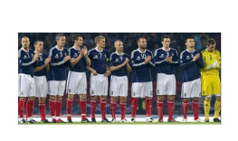
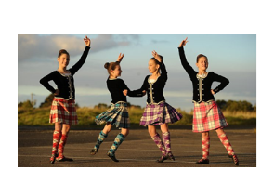
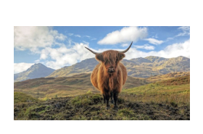
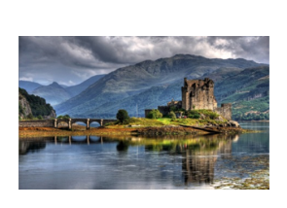
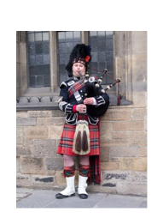
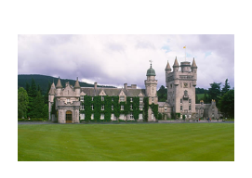
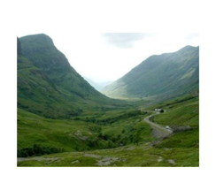
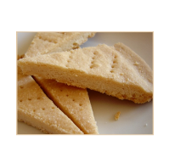
Scotland

Slide 12
LO: To identify the characteristics of the 4 countries that make up the UK.
The capital city of Northern Ireland is Belfast.
Have a look at the pictures on the next slide and discuss with a grown up what you the pictures tell you about Northern Ireland.

Slide 13
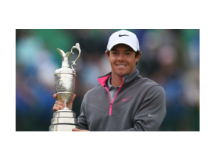
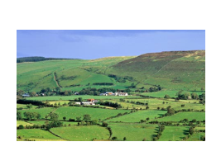
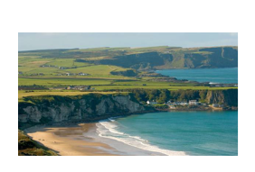
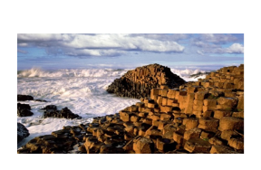
Northern Ireland

Slide 14
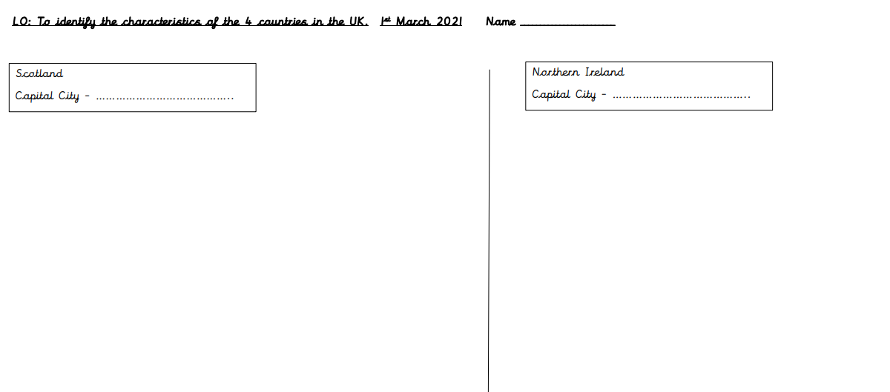
LO: To identify the characteristics of the 4 countries that make up the UK.
Your task is to divide a piece of paper into two or use the resource sheet provided.
Write down the capital city of each country.
Sort the pictures and stick them into the correct column.

Slide 15
LO: To identify the characteristics of the 4 countries that make up the UK.
Challenge – Have a look at the Union Jack, the UK flag. Then have a look at the flags for the four countries that make up the UK. What do you notice?

