Slide 1
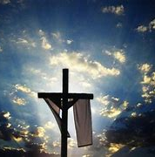
RE
LO: To explore the Easter Story

Slide 2
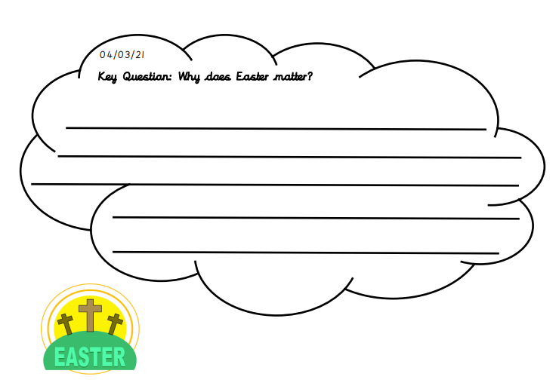
Why does Easter matter?
Before, we start our new topic about Easter, we would like to ask you to reflect about why you think Easter matters to Christians.
Write down your answer to this question in your exercise book or answer on the sheet provided.

Slide 3
LO: To explore the Easter Story
Watch the following clip to learn about the Easter Story:
Religious Studies KS1: The Christian Story of Easter - BBC Teach
You can also read the Easter Story, there is a version of the story on the website.

Slide 4
LO: To explore the Easter Story
Your task today is to re-tell the Easter Story. You could do this in a variety of ways:
Create a storyboard with pictures and writing.
Make a flap book with pictures telling the story.
Cut out the story sequence cards and put them in the correct order.
We look forward to you sharing your work and seeing what you have made.

