Slide 1


Section Title
As you go through the slides make notes in your home learning book.

Slide 2
Section Title
When was the last time you felt misunderstood?
Lesson
Notes:
Ask the group to think about a time when they felt misunderstood – what was that experience like?
People with mental health problems often feel misunderstood, because of general lack of understanding about mental health, the taboos and false negative stereotypes which are around. Time to Change is a national campaign which is trying to end all that, so that mental health can become an ordinary topic to discuss like any other.
This session will introduce you to the topic of mental health, stigma and discrimination, and the Time to Change campaign

Slide 3

Time to Change Mission
To make life better for everyone by ending the discrimination faced by people with mental health problems
To inspire young people to work together to break down the stigma that surrounds mental illness
Notes:
Ask the group - What is stigma? Can you think of any examples?
What is discrimination? Can you think of any examples?

Slide 4
Stigma and Discrimination
A definition of stigma: The experience of shame or disgrace that sets people apart and identifies them as being different or undesirable
A definition of discrimination: Less favourable treatment of people, which might include being less able to access opportunities and resources
Time to Change Children and Young People’s programme development Summary of research and Insights 2012
Notes:
Pull out the language that young people may relate to – bullying, teasing, judging people, excluding people, talking about people behind their back, name calling, making sweeping generalisations, blaming people for their mental health problems, labeling people as ‘attention seeking’

Slide 5
Quiz
How many young people will experience a mental health problem in any one year?
A: 1 in 10 young people
B: 1 in 100 young people
C: 1 in 1000 young people
Notes:
Answer - A

Slide 6
Quiz
What are the most common mental health problems experienced by young people?
A: Schizophrenia
B: Depression and Anxiety
C: Anorexia
Notes:
Answer - B

Slide 7

What is mental health?
Notes:
Split the group into 2 and give each a piece of flip chart paper.
One piece of paper should say ‘mental health’ and one should say ‘mental illness’
Ask the groups to spend time writing down all the words they associate with these terms
Ask each group to present.
Discuss – were the responses similar for each? Did anyone write anything positive which they associated with mental health (e.g. wellbeing, self esteem, experiencing a range of / recognising / understanding your emotions?)
Discuss - which terms do you think are appropriate? Which might be stigmatising?
Explain – we all have mental health, just as we all have physical health. Let’s now look at one definition of what mental health is (see next slide)

Slide 8
Definition of mental health
"The capacity to live a full, productive life as well as the flexibility to deal with its ups and downs.
In children and young people it is especially about the capacity to learn, enjoy friendships, to meet challenges, to develop talents and capabilities.”
Source: Young Minds 1999
Notes:
What do you think of this definition?
It’s positive, something we might all aspire to

Slide 9

True or False?
Section Title
Mental health problems make you weaker
You can recover from a mental health problem
I know someone with a mental health problem
There are ways you can help yourself feel better if you feel bad
Notes:
F – some people find that they are more self aware and feel stronger after having experienced a mental health problem.
T – recovery is possible, particularly if you have sought help early
T – 1 in 4 adults will experience a mental health problem so chances are you know someone
T – discuss what those ways are (e.g. talking to someone you trust, exercise, sleep, recognising and appreciating your positive attributes)

Slide 10
Different types of mental health problems
Section Title
Depression – lasting low mood, hopelessness, loss of energy
Anxiety disorders – lasting sense of worry, panic, dread which is affecting someone’s ability to live their life as usual
Eating disorders – may have an unrealistic view of their body shape and weight. Not just about dieting – can be related to low self esteem or coping with very difficult emotions or situations.
Self harm – often a way of coping with emotional difficulties.
Psychosis – change of reality. Sometimes hearing voices and seeing things that others don’t see or hear. May feel paranoid.
Notes:
Ask the group if they have any questions about any of these mental health problems.
Explain that we all feel low or anxious some of the time. The point at which we might be experiencing a mental health problem is when those feelings are persistent and unshifting or affecting our ability to function. It’s important to talk to someone you trust or seek professional help.

Slide 11
Section Title
Why do people develop mental health problems?
Some people feel it is a chemical imbalance in the brain
Some feel it is all about trauma (everyone has a personal story of trauma, abuse, grief, bullying, separation loss, etc)
Some feel it is about lack of money or privilege
There are a lot of views but it is important that someone’s personal view is listened to and respected
There is no one answer
Notes:
Anyone can develop a mental health problem.
You can recover from any mental health problem, particularly if you have sought help early.
You can have a mental health diagnosis and still lead a full life.

Slide 12
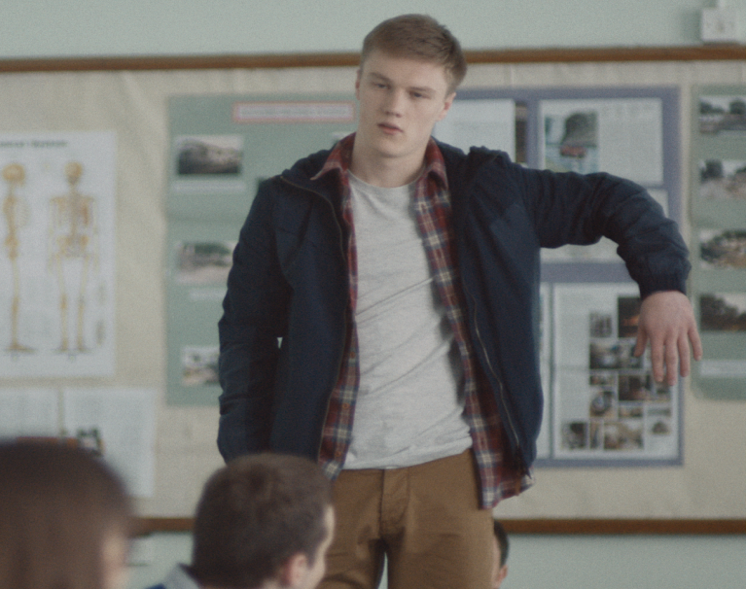
The Stand Up Kid (Click the picture)
Click Here for video
Notes:
Show the Stand Up Kid film
Ask the group for their reactions:
- how do they think Michael was feeling?
- What do you think led Michael to do what he did? (bullying, teasing, or maybe just being left out and forgotten about by his friends)
- If you were re-playing the story from the beginning - what could Michael’s teacher and peers have done differently, to help welcome him back?

Slide 13
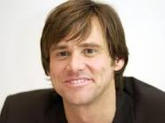



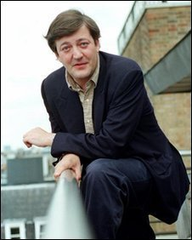


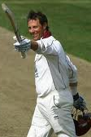
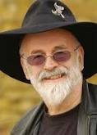



Can you match the celebrity to their mental health problem?
Jim Carrey - Actor
Gail Porter –
TV presenter
Stephen Fry –
Writer/ presenter
GoK Wan – Fashion Designer
Frank Bruno - Boxer
Obsessive Compulsive Disorder
Depression
Stress-Related Illness
Alzheimer’s Disease (Dementia)
Bi-Polar Disorder
Post Natal Depression
Panic Attacks
Demi Lovato
Kerry Katona –
Reality TV contestant
Marcus Trescothick - Cricketer
Terry Pratchett –
Discworld Author
Susan Boyle – Singer
Britney Spears - Singer
Catherine Zeta Jones - Actor

Slide 14
They are just a few but read this link…
Mind Mental Health Ambassadors (Click Here)
As you can see, this is not something that just affects one person, it affects anybody.

Slide 15
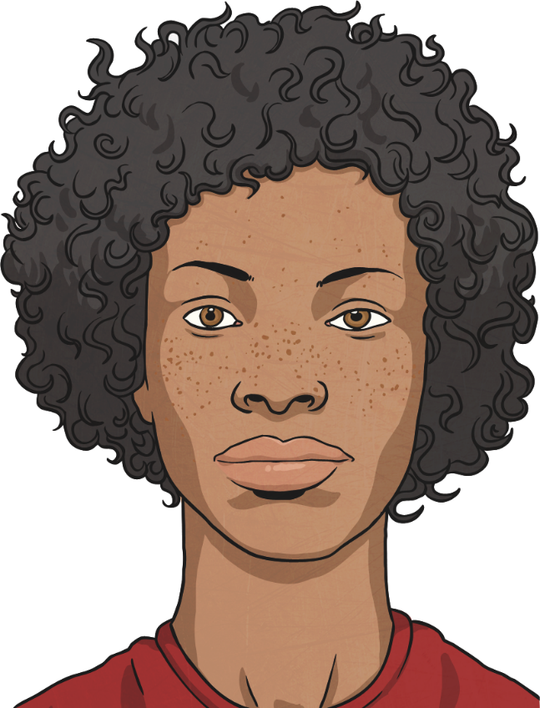
How Are You Feeling?
Sometimes we can’t always explain how we are feeling. That’s usually the time someone we know asks us if we’re ok.
Sometimes we feel low, anxious or unhappy and we can’t think why.
Feeling like this is ok. But sometimes we feel like this for so long that we don’t want to do anything at all.

Slide 16
What Happens?
If we feel unhappy and we can’t explain why, sometimes things can get out of control.
Think about a time when you felt out of control.
Did you lose your temper?
Did you throw something?
Did you shout at someone?

Slide 17
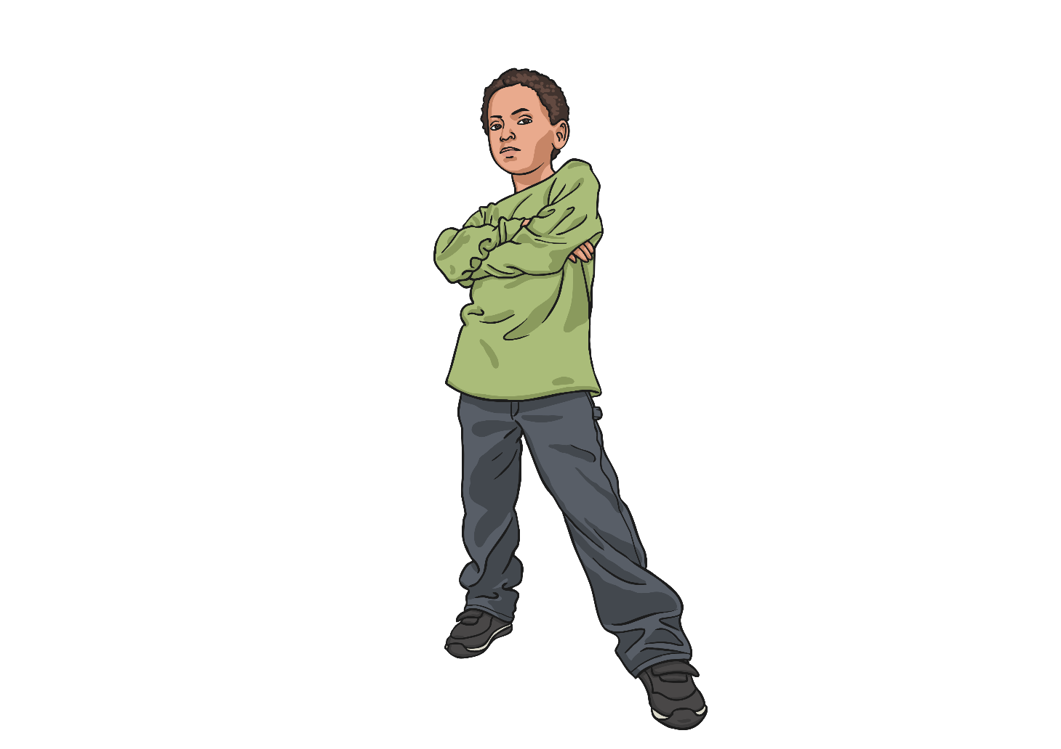
What Might Happen?
If we don’t deal with these feelings, things can get very messy. We might fall out with our friends. We might get into trouble at school. Our parents might get angry with us.

Slide 18
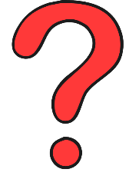


What Can We Do?
We often feel out of control of things that happen in our lives. We get told where we need to be, what time we have to leave, who’s picking us up, even where we might be sleeping that night.
We might have so many thoughts in our head that they start to get muddled up.

Slide 19
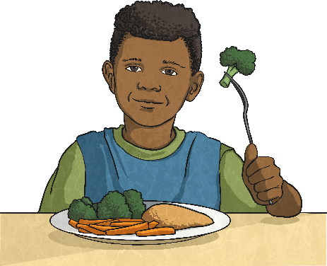
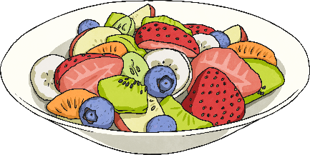

Eat Well, Feel Well
We have all been told about healthy eating, and usually it’s to keep our bodies fit and healthy. However, a good diet helps our mental health too.
Don’t skip meals. We are designed to have three meals a day with some healthy snacks in between. If we don’t eat regularly or healthily, we can feel grumpy, tired, lose concentration and lack motivation to do anything.
Eat breakfast every day. Our bodies and minds have run out of fuel during the night and we need to give ourselves a good start.
Avoid takeaways and ready meals. They are often full of things which don’t help our minds to work efficiently.
Drink at least 6 glasses of water a day. It’s vital for our brain’s wellbeing.

Slide 20
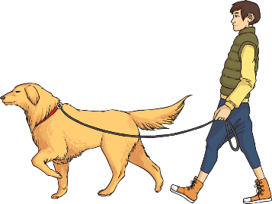
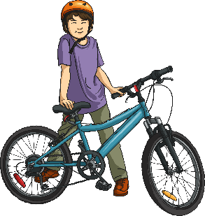
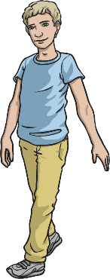

Get Out There!
Exercise is very important for your mental health. Moderate exercise is recommended for up to 30 minutes a day. Have a go! You could:
Walk the dog
Ride your bike
Walk to school
Rollerskate

Slide 21
Help Other People
There’s nothing like the feeling you get when you are appreciated by other people. Helping them is a great way to do something useful but also feel good about yourself.
Is there a neighbour you can pop to the shop for?
Have you got a Grandma who needs help with making tea?
Do you have a younger brother or sister who you could read to at bedtime?

Slide 22


Think Good Things About Yourself
Thinking positively is tricky when you feel low, but following a few of these tips could help that downward spiral of negativity.
Consider your achievements – all those swimming certificates and dance exams mean you are doing really well!
Avoid people who are unkind to you. Don’t try to make them be friendly.
Control your temper and walk away. Breathe deeply and concentrate on that until you feel calmer.
Think about things you enjoy doing and that you’re good at.

Slide 23
Take Time Out
Things get really hectic at school these days and we can be just as busy at clubs and groups we go to after school. When do we make time for ourselves?
Recharge your batteries – even if you just lie on your bed for 10 minutes in peace and quiet.
Write down how you’re feeling. It’s a good way to get things off your mind without upsetting anyone else.
Think of your favourite place. Remember what you might hear, see and feel like when you’re there.

Slide 24
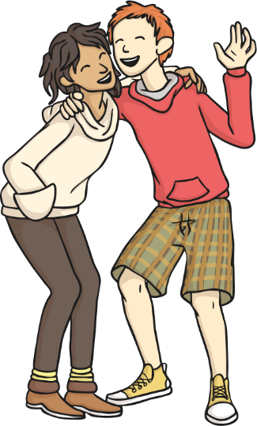
Spend Time With Friends
Our friends are called friends for a reason!
Arrange to see a friend so that you have something to look forward to – maybe a trip to the cinema or shops.
If you have been spending a lot of time on your own recently, actively go and find a friend to spend time with.
Confide in someone you trust. Tell them how you’re feeling. You never know, they have probably felt like that too, and might have some good advice.

Slide 25
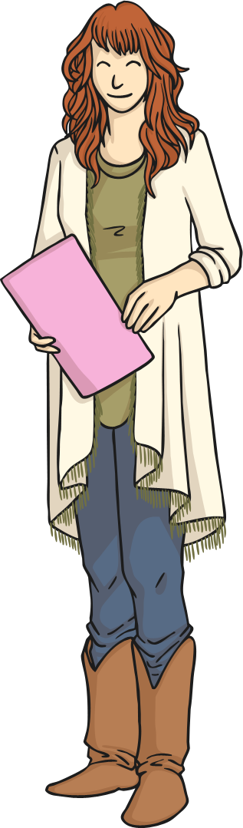
Ask For Help
There are people out there to help you.
Ask for help.

Slide 26
Your task today
You are going to be creating your own mental health booklet that could give people tips on how to feel better. Title it:
My Little Book of Well-Being Tips
Make sure you include all of the things we have discussed today and give people tips and advice on how they could help themselves feel better mentally. With what is going on currently in the world, this is more important than ever.
Make sure you booklet is creative and has year 6 standard presentation. This can be done as a PowerPoint or any way you choose to present it.
Use your notes to help you create this.
There is a video tutorial below to show you how to create a booklet if you want to do it that way, all you need is some A4 plain paper ☺

