Slide 1
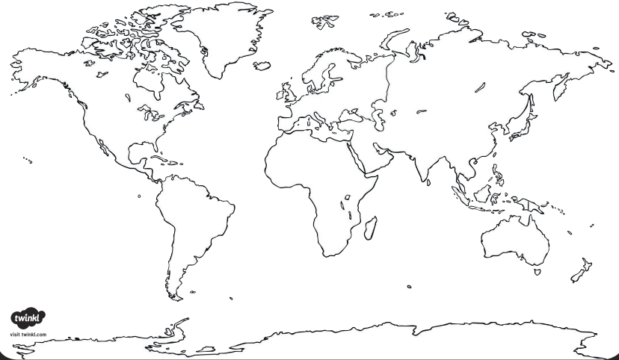
LO: To revise mountain ranges of the world
Below is a map of the world. Use the mountain ranges from the board and Google Maps to label where they are in the World.

