Slide 1
Graphic scores

Slide 2
What is a Graphic Score?
We use a “score” to put musical notes on, so that the performer knows what to play.
A graphic score is a score that uses different symbols or pictures instead of notes. This gives the performer more freedom in how to play the music.
Have a look at some examples on the next slide…..

Slide 3
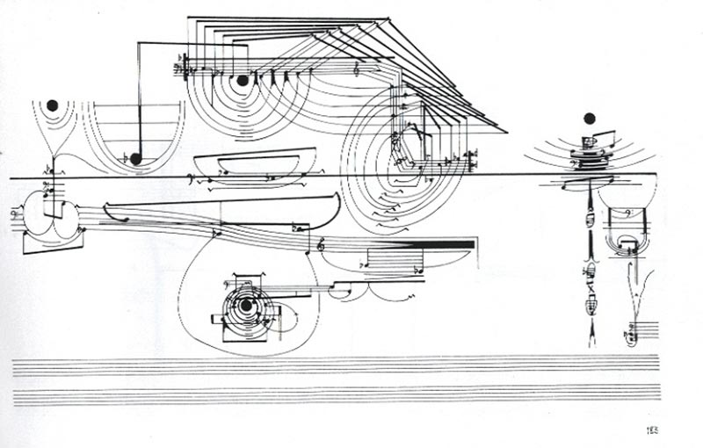
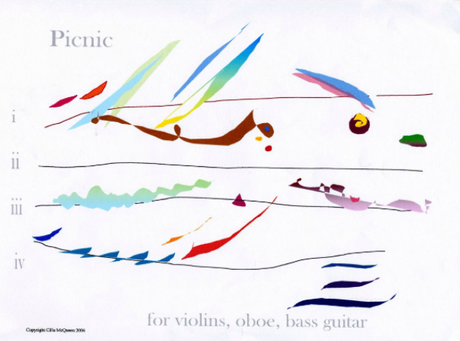

Slide 4
The good thing about graphic scores is that there is no right or wrong ways of playing it.
Take this for example:
There are many different colours and directions happening in this piece. Have a little think of what each line could mean……
- The different colours could mean different instruments or sounds.
The lines going up could mean that the sound is going higher or louder, and the lines going down could mean going deeper or quieter.
The bolder colours could mean loud sounds and the softer/pastel colours could be quieter sounds.
See! No right or wrong answers! (unless the composer writes a key in the music……)

Slide 5
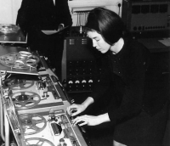
Why are we doing this?..........because we are going to create our own graphic scores.
First we need to meet this lady…..
Delia Derbyshire.
I very much doubt if you’ve heard of her, however you might recognise this famous theme tune...
https://www.youtube.com/watch?v=75V4ClJZME4

Slide 6
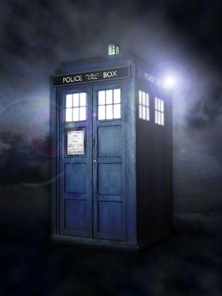
The original Doctor Who theme tune.
Now Delia wasn’t the person to write the music (or compose). That was somebody called Roy Grainer. However, the producers wanted the theme tune to be a bit more futuristic and sci-fi to match with the character. This was Delia Derbyshire’s task.
She used ‘found sounds’ – sounds that are found in the ‘natural world’ or from non-musical objects and then used to make music. She recorded the sound of everyday objects onto tape and then changed the speed of the tape to create different notes or looped the sounds over and over to create a rhythm.

Slide 7
Challenge Time!
Listen again to Delia Derbyshire’s Doctor Who theme tune. On a piece of paper, draw the sounds you can hear. Remember there is no right or wrong!
You could for the high tune, draw one line that goes higher up the page or lower depending on what happens in the music. This tune doesn’t stop much so try to keep your line continuous.
Listen to the bass line (the low bit). Can you hear it go….. Duh duh duh duh duh duh duh duh……etc. How could we draw this? Maybe four little circles in a line? This part isn’t smooth so don’t make your line smooth.
Compare with others. You will find that no two drawings look the same. And now you have your first graphic score!
To be continued…….

