Slide 1
Graphic score
Part 2

Slide 2
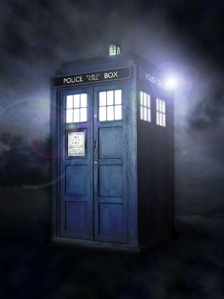
Quick Recap…..
Last time, we talked about graphic scores and how there was no right or wrong to them….
We met a lady called Delia Derbyshire, who arranged the original Doctor Who theme and made it sound more futuristic by using found sounds (more about this today)…..
And we created our first graphic score to the Doctor Who theme and compared them with other people’s.
Here’s the tune again…..
https://www.youtube.com/watch?v=75V4ClJZME4

Slide 3
Warm-up!
There’s a punchy bass-line that happens underneath the tune for Doctor Who. All we need to do to recreate this is say “Doctor Who….Doctor Who…..Doctor Who…..”. It doesn’t matter about speed. Everyone will be slightly different.
Next, clap the syllables as you say Doctor Who. Can you count three syllables?
Doc-tor-who doc-tor-who….
This is what it looks like (this is what you are doing without realising!)
Challenge:- if you are finding this easy, try clapping it with somebody else……at different speeds! Can you still do your part?
Or try doing it like a round, when one person starts after the first person……

Slide 4
Found sounds….
Last time we said that Delia Derbyshire used found sounds to record and change electronically to create these futuristic sounds, but what are found sounds?
Found sounds are sounds found in the ‘natural’ world or made from non-musical objects and then used to make music.
So this could be…..a chair scrapping on the floor……a pencil rolling off the table and landing on the floor……a door squeaking……people walking up and down stairs……

Slide 5
You’ll need a piece of paper and a pencil/pen……
Close your eyes. Listen for the sounds that are happening in your environment and write them down. No sound is too silly. It could be a car driving past, your fridge humming, birds tweeting outside, anything.
Compare your list with somebody else. You might notice that you missed some sounds that somebody else heard or they missed some sounds that you heard. Remember: no right or wrong.
Next, think about how we could draw these sounds in a graphic score.
For example, a pencil rolling off a table onto the floor could be drawn by a little wobbly line (for rolling) and a big thick squiggle (for falling on the floor).

Slide 6
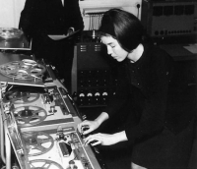
You could try this in different rooms to see if you can hear different sounds.
This is all Delia Derbyshire did. Ok, she recorded the sounds and messed about with the sounds on the computer until it made the sound that she wanted however it’s the same idea. She just recorded sounds that she could hear.
Delia was not credited for her work on this now iconic theme tune and didn’t earn much money from it. Can you imagine how weird the tune would sound without Delia?

Slide 7
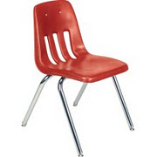
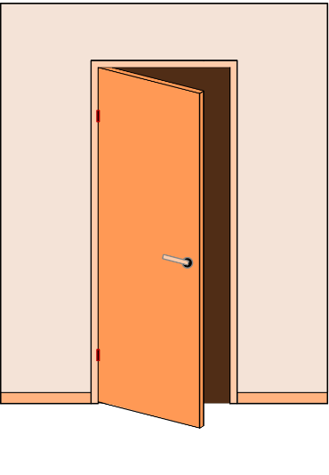
Challenge (and performance) time!
Look at your graphic score of your found sounds. Perhaps use different colours for the different sounds and work out how you are going to perform this to others. It could be that the pencil falls first, then the chair scraps and then the door squeaks.
Get somebody else to perform your piece and see how they interpret from your score. They might think that one line means something else (last time: no right or wrong!).
Or……turn your score upside down. Means something completely different now!

