Slide 1
Children’s mental health week 2021
w/c 1st February 2021

Slide 3
Children’s Mental Health Week 2021
This week in school we would have been focusing on children’s mental health week, so we want to continue this plan even in lockdown as it is so important.
This year the theme is ‘Express Yourself’.
Each day there will be a P4C starter question set at the morning Teams meeting for children to reflect upon and share with their families.
There will be time in the day to do some yoga, calming strategies or mindfulness activities.
There will be some PSHE challenges around pupil wellbeing e.g. self esteem, celebrating success, overcoming challenges and worries.
There will be creative activities.

Slide 4
Plan for the week
Monday – dress to express yourself ☺ If you want to dress up for your Teams call in an outfit that best represents yourself you can do – optional. It might be your favourite clothes, sports kit, something linked to a hobby, or just a bright, colourful accessory or hat
Tuesday – focus: inspirational people
Wednesday – focus: being creative
Thursday – focus: being resilient and overcoming challenges – how can we deal with our worries?
Friday – inside out day – celebrate the work this week by thinking about the way we present ourselves on the outside, and how we might be feeling on the inside. If you want to, wear your clothes inside out

Slide 5
School staff
Everyone in school is here to support you and your children – the teachers, the teaching assistants and other adults in school.
The following slides show some familiar faces that you can ask for help in school.
The weekly newsletter has many links at the bottom about self-help support services, and up to date information about other support available – please contact one of the people on the next 2 slides if you have any worries or would like some advice or support – if we can’t help you ourselves, we can find out who can and start the process. Our cluster of schools offers a lot of support services for children and parents/carers (counselling, relationship advice, food banks, parenting skills etc.)
The school website has a tab on the front page called inclusion and parental support with useful links and information

Slide 6
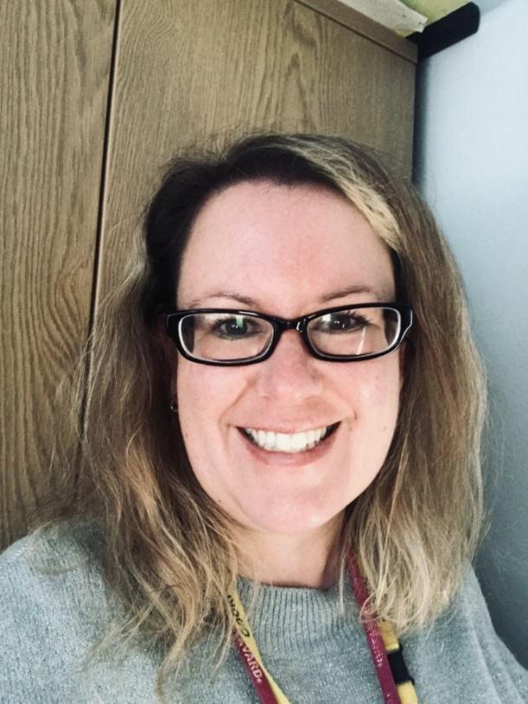
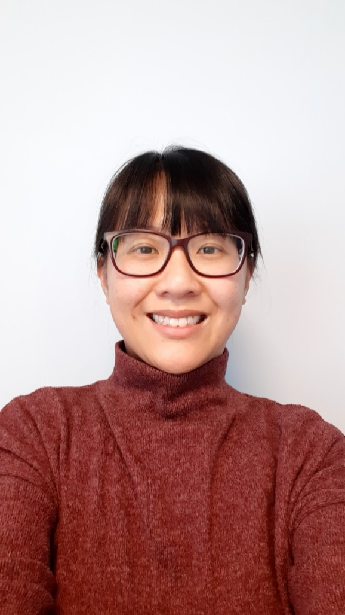
Who can help?
Miss Chang
I am the SENDCo in school which is about supporting children with special educational needs. I can help them with their learning or behaviour by supporting them in school, giving them and their parents advice and strategies, or seeking help from outside of school if we want some more support.
Mrs Casling
I am the Deputy Head and Inclusion leader in school – this means I have an overview of all classes and make sure anyone who might need some extra support gets it. I can also help parents/carers if they need support and I work with adults from other schools to find the best help and advice for people. I also run the school council to make sure pupil voice is heard in school.

Slide 7
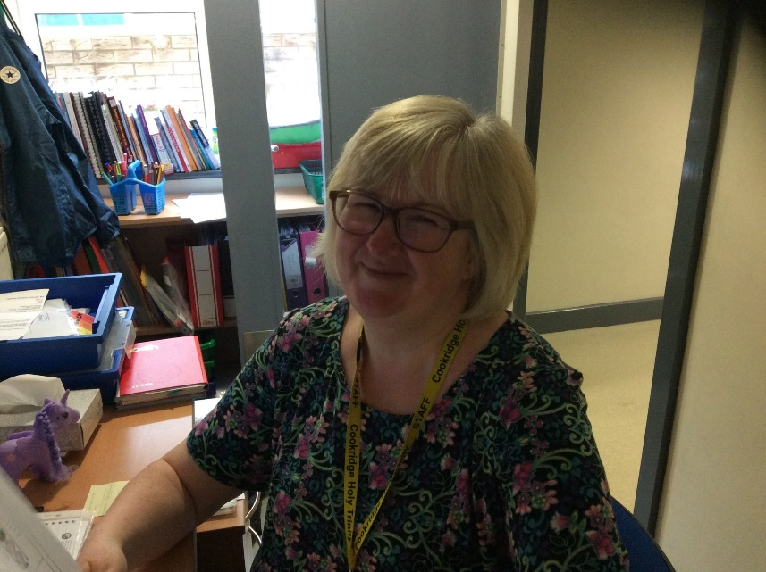
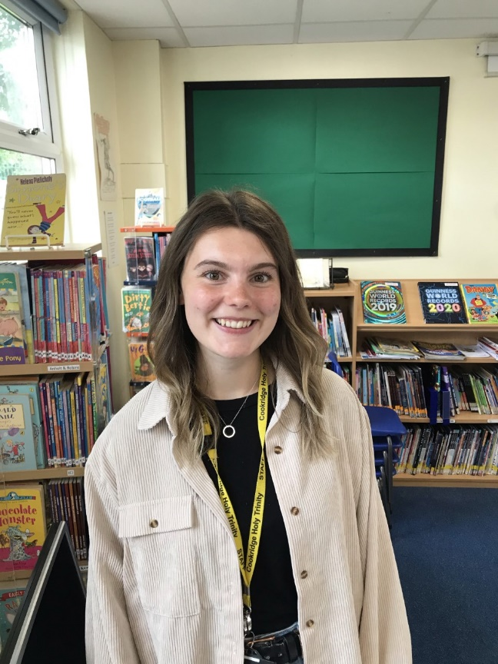
Miss Russell
I am the PSHE leader in school and teach in Year 3. I oversee the PSHE curriculum in school to ensure pupils are taught progressively about health and wellbeing, and ways to keep themselves safe. This year I will be reviewing the curriculum to include the updated national curriculum relationships education element.
Mrs Al-Kaseed
I am the learning mentor in school. I visit individual children to talk about things that might be worrying them, and I also work with small groups to develop skills that will help them at school and at home. I have lots of books and games and resources that I can use or recommend to teachers and parents. I am in regular contact with parents about support available and am always happy to offer a listening ear and advice.

Slide 8
Support available
If at any time parents/carers have any concerns about their own wellbeing or family relationships; the way their children are coping with home schooling; or any worries about more practical issues such as food, bills, parenting difficulties etc... we can access various support services via the local cluster. Please ask if you need anything, we may be able to help 😊. Please contact Mrs Casling via the info@holytrinity.leeds.sch.uk or telephone school at any point and I will get back to you.

