Slide 1
Mindful Art

Slide 2
Last week, I went for a walk past a place where a snowman had been built. On the ground lay two stones and a curved stick. I picked up the stick and put it in my pocket, laughing to myself. I had the smile of a snowman in my pocket.
In today’s lesson, try to look at things in a different way.

Slide 3
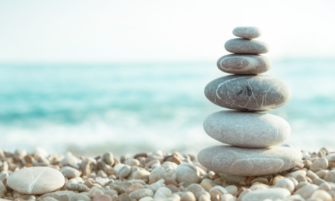
The Art of...
You have three choices which all involve mindfulness.
Mindfulness helps us to recognize what is going on in the present moment. Often at school we focus on the result but we also need to develop flexible methods to create results. Mindfulness can help us do this. It is an energy that we create within ourselves.
Construct an Inukshuk (then take a picture)
“Awe” walk(then compose a picture/collage)
Pebble meditation(take a picture of your pebbles)

Slide 4
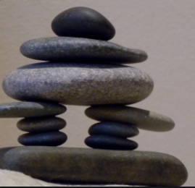
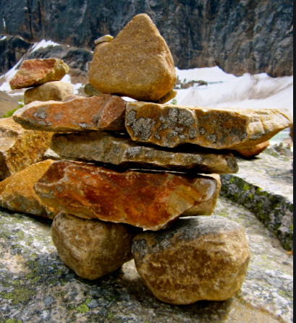
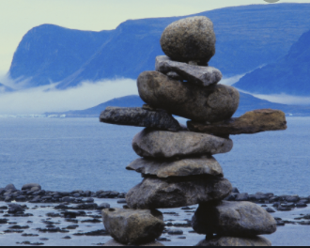
Inukshuk
An inuksuk is a manmade stone landmark or cairn built by the Inuit and other peoples of the Arctic region of North America. They were often stones balanced on one another to create a tall structure but sometimes they resembled humans, like the pictures below. Inukshuks can be symbols of hope and friendship that transcend borders.
For more information about inukshuks click here
https://www.cbc.ca/kidscbc2/the-feed/do-you-know-what-an-inukshuk-is

Slide 5
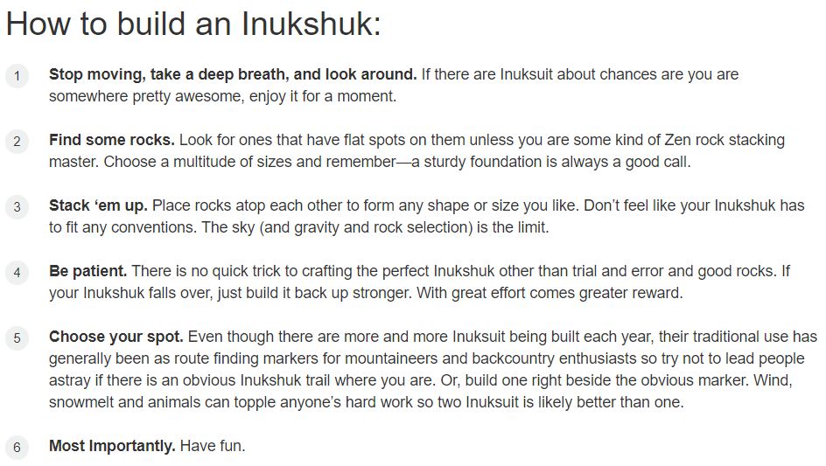
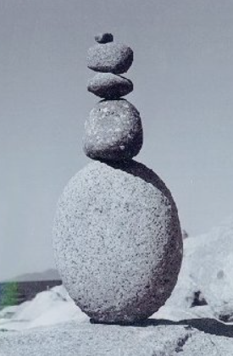

Slide 6
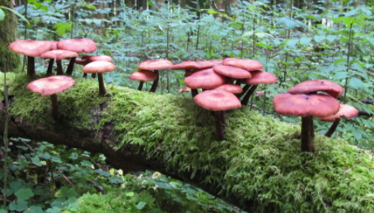
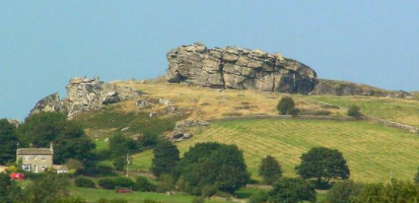
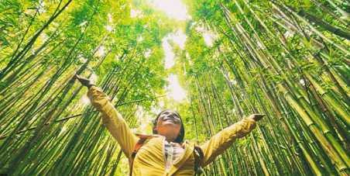
Awe Walk
An “awe walk” is a stroll in which you intentionally shift your attention outward instead of inward. So, you're not thinking about unfinished projects, messy bedrooms or the coronavirus.
With the right outlook, awe can be found almost anywhere, turning a mundane experience into a flight of inspiration and wonder.
The key is to be in the right frame of mind. To get started, turn off any gadgets and go out. When out, try to approach what you see with fresh eyes, imagining that you’re seeing it for the first time.
The next slide tells you how to do this…

Slide 7
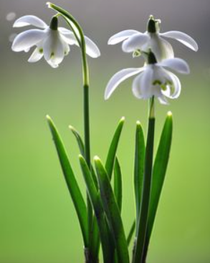
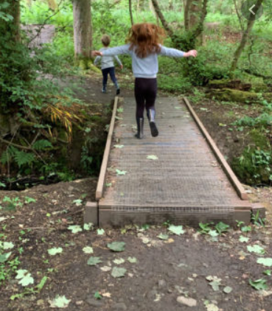
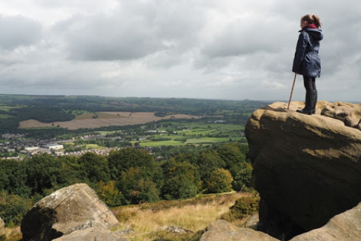
How to do an awe walk
After walking for a while:
Take a deep breath in. Count to six as you inhale and six as you exhale. Feel the air move through your nose and hear the sound of your breath.
2. As you start to walk, feel your feet on the ground and listen to any sounds. Be open to what is around you, to things that are vast, unexpected, things that surprise and delight.
3. Take another deep breath in. Again, count to six as you inhale and six as you exhale.
4. Let your attention be open in to what inspires awe in you. Is it a wide landscape? The small patterns of light and shadow? Let your attention move from the vast to the small.
6. Continue your walk and bring your attention back to your breath.
Notice—really notice—the multitude of sights, sounds, smells, and other sensations that are dancing through your awareness, usually undetected.
Task:- At the end of your walk make a collage or drawing of your moment of ‘awe.’

Slide 8
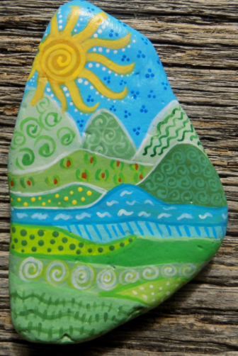
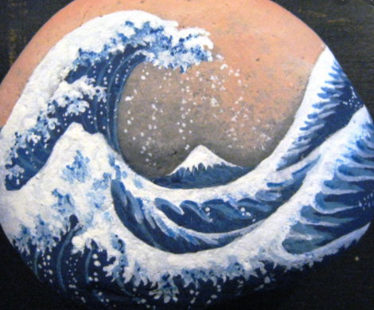
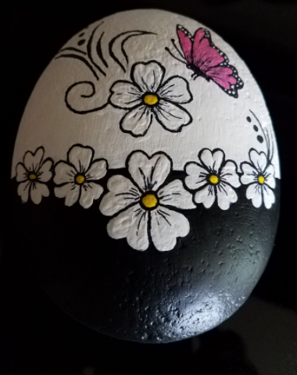
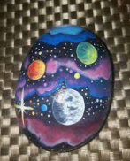
Pebble Meditation
This is a practical strategy to help cultivate peacefulness within.
Through mindful breathing and visualization, the qualities of freshness, solidity, clarity, and freedom are cultivated using the images of a flower, a mountain, still water, and a spacious blue sky. The pebbles help us make abstract concepts into something more concrete.
You can do this meditation sitting in a quiet space or have the stones in your pocket and go for a walk.
Step 1.
Select four pebbles to decorate. You can use paint or permanent markers.
The first pebble represents a flower.
The second a mountain.
The third water.
The fourth space.
Each pebble is going to be a reminder of a quality we are trying to cultivate in ourselves.
NB. PVA glue will seal your pebbles to make them waterproof

Slide 9
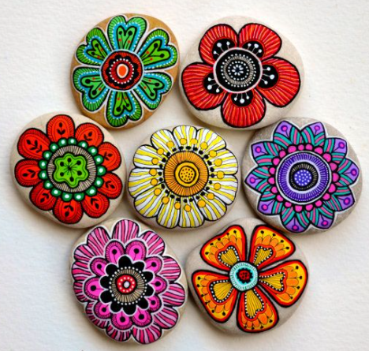
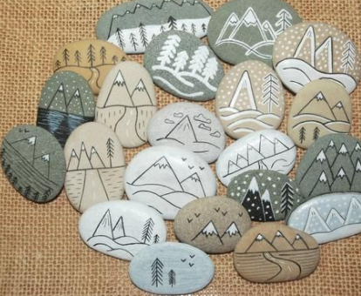
Step 2.
To meditate breathe in and out deeply
Hold the first pebble, say to yourself:-
Breath in: I am a flower.
Breath out: I feel fresh.
We imagine we are beautiful flowers in a garden of humanity.
breathe in and out deeply
Hold the second pebble, say to yourself:-
Breath in: I see myself as a mountain.
Breath out: I feel solid.
The mountain knows it’s solid no matter what is going on around it.
breathe in and out deeply

Slide 10
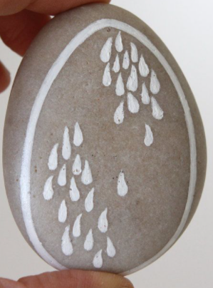
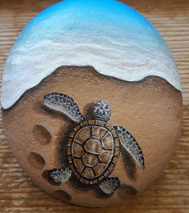
breathe in and out deeply
Hold the third pebble, say to yourself:-
Breath in: I see myself as still water.
Breath out: I reflect things as they are.
When we are calm, we can make better decisions.
breathe in and out deeply
Hold the fourth pebble, say to yourself:-
Breath in: I see myself as space.
Breath out: I feel free.
When we give ourselves freedom we feel free from worry or anxiety.
breathe in and out deeply
The purpose of this lesson is to teach students practical strategies to help them cultivate peacefulness within so they can be peaceful in the world.

Slide 11
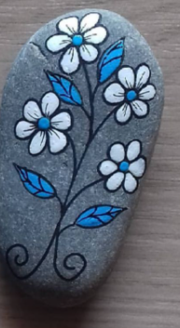
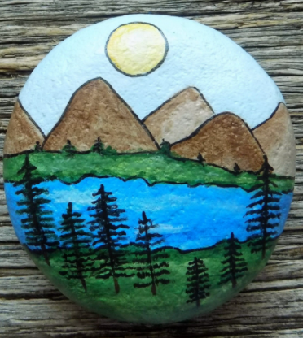
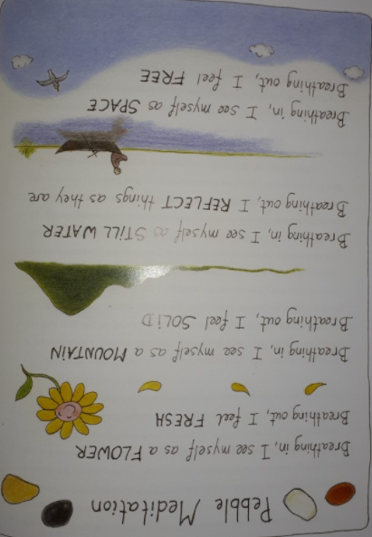
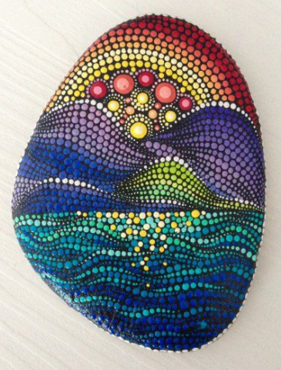
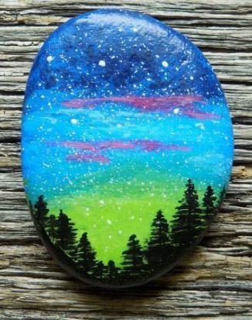
More Ideas

Slide 12
Namaste
namaste literally means "bowing to you". In Hinduism, it also has a spiritual meaning reflecting the belief that "the divine and self is same in you and me", and so can mean
"I bow to the divine in you".

