Slide 1
Internet Safety
Click Clever. Click Safe.
Internet safety guidelines for children to follow and learn.

Slide 2
Today you will be making notes as we go through the slides.

Slide 3
The internet is amazing when used safely and correctly.
Here are some simple rules that will help you make sure it stays amazing so that it plays a healthy part of your life.

Slide 4
Social Networks
Do you use any of these?
Did you know that it is illegal to have any of these accounts if you are under 13?
If your parents set it up for you, then you are required to be under adult supervision when using it.
Photo courtesy of (Jon@th@nC@flickr.com and forche.6@flickr.com) - granted under creative commons licence – attribution

Slide 5
Social Networks
Never share your personal information with anyone online. This includes your name, address, phone number and any school information. Get your privacy settings right!
Remember that anyone can be anybody online. An internet friend that you may think you have known for ages is still a complete stranger in real life.
Use a nickname instead of your real name and put up an avatar of yourself on your profile rather than a real one.
Keep your passwords safe by changing it regularly. It will be much more difficult to guess if you do.

Slide 6
Teacher Friend Requests
Though teachers and school staff would love to talk to you in real life, pupils are not allowed to add teachers as friends on Facebook. At the same time, teachers are forbidden to respond to such requests if they are made so please remember this!

Slide 7
Blocking Wisely
Block and delete any emails from anyone you don’t know.
Do not open any attachments from people you don’t know as it could be a nasty virus!
If anyone sends you a nasty email or messages, just block them. Arguing will not help, and you do not have to put up with it!
This applies to all devices that use the internet e.g. Games consoles (such as xBox or PS4) and tablets (such as iPads).

Slide 8
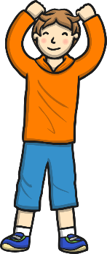
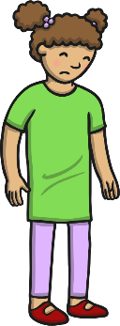
Cyber Bullying
Cyber bullying is no different to bullying in real life.
If someone says something that upsets you, you need to tell someone you trust about it, such as a teacher or parent and block the bully.
Remember that typing something nasty in a message to someone is just as upsetting as saying it to their face. Think before you send!

Slide 9
Meeting People Offline
Never meet anyone from the internet without an adult with you as this is very dangerous!
Talk to a trusted adult about it.

Slide 10
The main thing to remember is:
Be smart and safe by making the right choices.
If you are ever unsure,
ASK for help and advice.
Do not deal with it alone!
Happy Surfing

Slide 11
As well as keeping safe online, we must keep our mental well-being happy too.
Social media and the internet has many positives such as:
Creates social support
Keeps you in touch with family/friends who live far away
Helps some people be more honest with their friends
Makes some people feel less alone
Provides easier access for support with mental well-being

Slide 12
With anything, there are also some downsides to social media and the internet:
It can make people feel less satisfied with life (compare yourself to others)
Can distort body image (think back to PSHE on Weds)
Can add to the negative feelings that you might be feeling already
Can expose some people to bullying
It can create social anxiety
16% of children aged 8-11 have reported they have seen content that is ‘worrying or nasty’

Slide 13
So what can you do to help others?
If you see anything that you shouldn’t- let a trusted adult know and report it.
Do not get involved with cyber bullying; this could be online or via chat groups
Make sure you have a balance of online and offline life.
Do not believe everything you see on the internet, a lot is made to look better than it is.

Slide 14
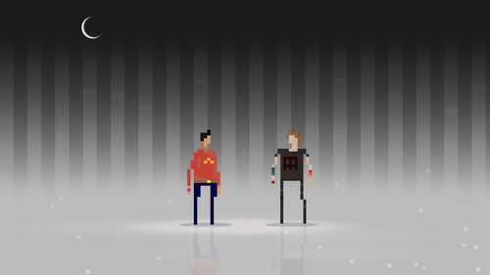

Slide 15
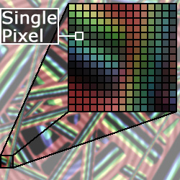
What is a pixel? The term "pixel" is actually short for "Picture Element." These small little dots are what make up the images on computer displays, whether they are flat-screen (LCD) or tube (CRT) monitors. The screen is divided up into a matrix of thousands or even millions of pixels. Each pixel can only be one color at a time. However, since they are so small, pixels often blend together to form various shades and blends of colors.

Slide 16
Pixel Art in computer games
Pixel art is generally thought of as a computer graphic where the image is literally drawn pixel-by-pixel in tiny detail, usually using a limited color palette. Pixel Art is a form of digital art inspired by the 8-bit and 16-bit computer games from the 80’s and 90’s.
It has been hugely influential- see if you can recognise some of these computer game characters:

Slide 17
Mario

Slide 18
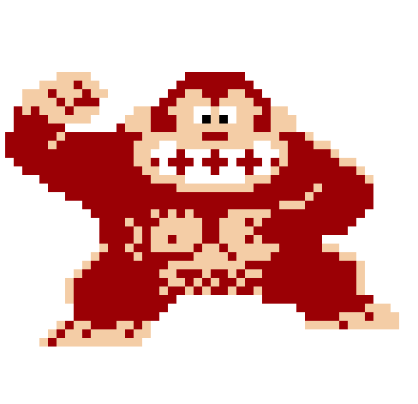
Donkey Kong

Slide 19
Link- From Zelda

Slide 20
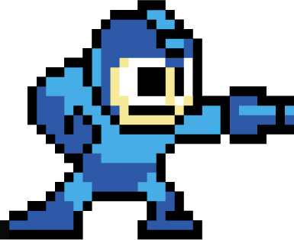
Megaman

Slide 21
Sonic the Hedgehog

Slide 22
These characters are still very popular today and there is a lot of nostalgia attached to these designs. You will learn how to make yourself into a pixel art character:

Slide 23
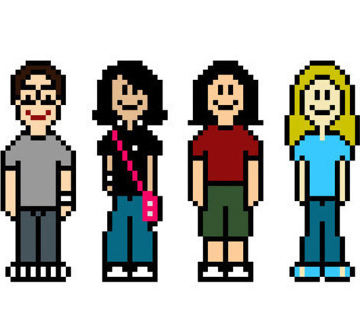

Slide 24
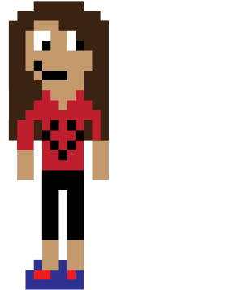
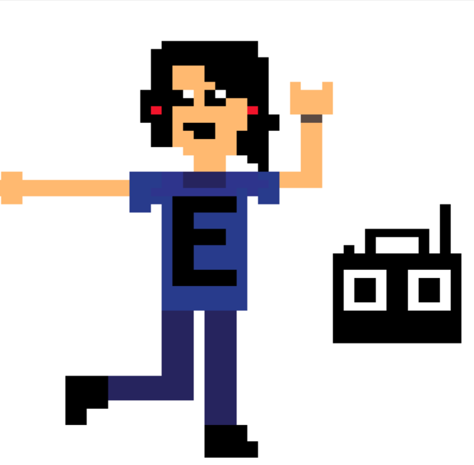

Slide 25
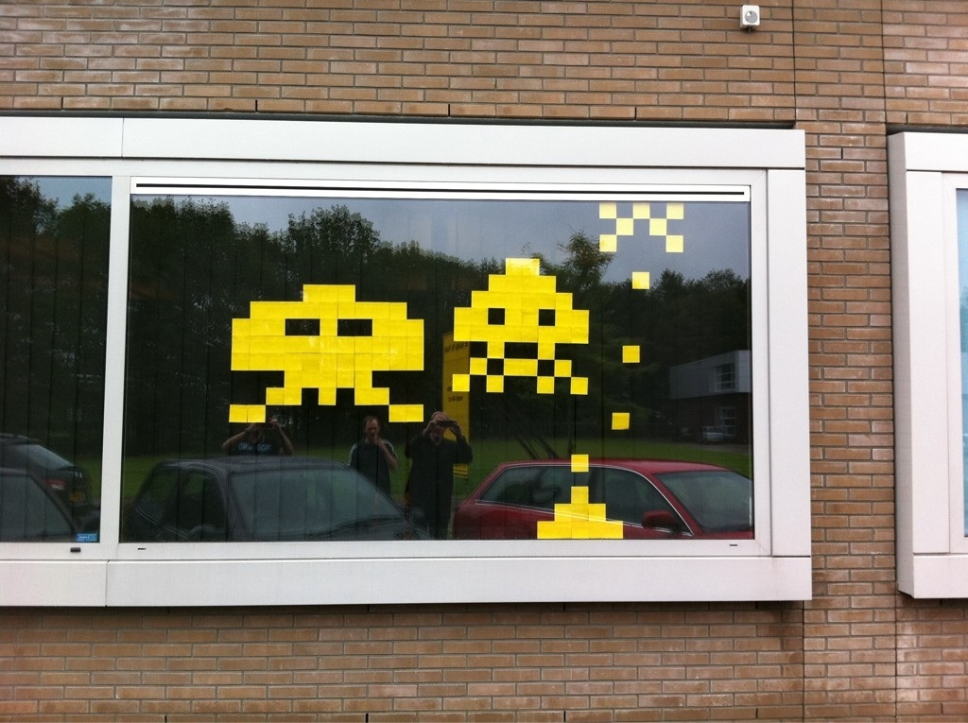
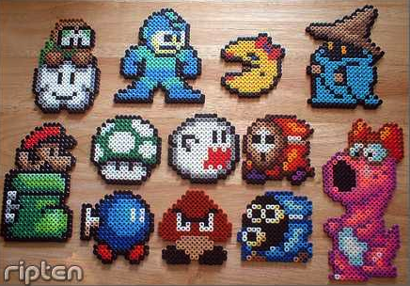
Also Pixel Art can be used to make many things:
Post It Notes Space Invaders
Perler Bead Characters

Slide 26
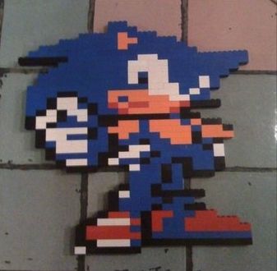
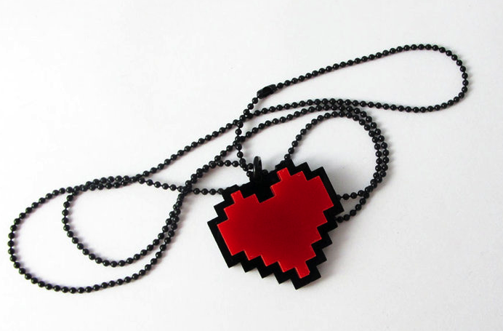
Pixel Art Necklace and Jewelry
Lego Pixel Art Character

Slide 27
Have a look at how to do this by using the video attached:

Slide 28
Today
Your task will be to use pixel art to create your own ‘Safer Internet Day’ help and guidance poster.
Your poster should include:
Something that shows how to be e-safe
A title of Safer Internet Day
A creative use of pixel art
You should also mention how we can keep our mental well-being positive through the internet.

